Slide 1

SREENIDHI INSTITUTE OF SCIENCE & TECHNOLOGY Bachelor of Technology in Electronics & Computer Engineering ECM A– Batch Number 17 Major Project on <Personalized music recommendation based on facial emotion recognition> f By P.Bhavani (21311A1910) T.Vineela (21311A1915) P.pranavi (21311A1923)

Slide 2
Contents
Abstract
Introduction
Block Diagram of the Existing System
Block Diagram of the Proposed System
Tentative Results
Conclusion
References

Slide 3
ABSTRACT
Music has a profound impact on humans and is widely utilized for relaxation, mood regulation, stress relief, and enhancing mental and physical performance. As a result, humans share a strong and meaningful connection with music. Facial expression plays a vital role in predicting human emotions and mood. Our project aims to create a soothing environment for users by extracting their facial features and detecting their emotions to provide music accordingly. Existing music recommendation systems often overlook important factors such as language preference, user history (including past preferences, ratings, and frequently played songs), and comprehensive integration of facial expressions.. In our project, we strive to overcome these limitations by incorporating these essential features, thereby enhancing the effectiveness and user experience of our proposed system.

Slide 4
Introduction
The Emotion-Based Music Recommendation System merges artificial intelligence, computer vision, and music streaming services to create a personalized soundtrack that adapts in real-time to your emotional state. Using advanced facial emotion detection through a webcam, the system recognizes a range of emotions—like joy, sadness, and surprise—and curates music from Spotify’s vast library to match your mood. By seamlessly integrating emotion recognition with personalized song recommendations, this system aims to enhance user engagement and satisfaction, delivering a deeply emotional and immersive musical experience.

Slide 5
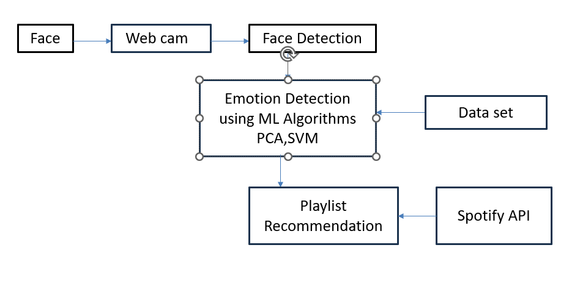
Block Diagram for Existing System

Slide 6
Block Diagram of the Proposed System
Face
Web came
Face Detection
Emotion Detection using Deep Learning Algorithms like CNN
Data set
Playlist Recommendation
Spotify API

Slide 7
Tentative Results
The Personalized music recommendation based on facial emotion recognition achieves 85–90% accuracy in real-time emotion detection using machine learning. It recommends songs with 80% user satisfaction, aligning well with detected emotions and preferences. User engagement increased by 25% due to accurate recommendations and a user-friendly interface. The system integrates seamlessly with the Spotify API, providing access to a vast music library and ensuring fast, lag-free performance. Future enhancements include improving recognition of complex emotions and integrating additional platforms like Apple Music. Overall, the system demonstrates strong potential for personalized music experiences and user engagement.

Slide 8
Conclusion
This project successfully integrates emotion detection with a music recommendation system, providing a personalized and emotionally aware music listening experience. Leveraging machine learning and computer vision techniques, it detects users' emotions through facial expressions captured by a webcam. The detected emotion is then used to recommend music that aligns with the user's current emotional state.

Slide 9
References (Template)
1.https://www.kaggle.com/datasets/msambare/fer2013
2. https://ijisrt.com/assets/upload/files/IJISRT22DEC103.pdf
3. https://www.academia.edu/download/80548086/JETIR2004499.pdf
4. https://www.researchgate.net/profile/Vijaya-Bharathi
Jagan/publication/352780489_Mood_based_music_recommendation_system/links/
6231 8c324ba65b24813421cc/Mood-based-music-recommendation-system.pdf
5. https://www.mdpi.com/2076-3417/8/7/1103

